Slide 1
Chemical Synthesis

Slide 2
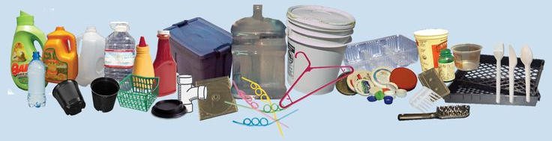
Polymers

Slide 3
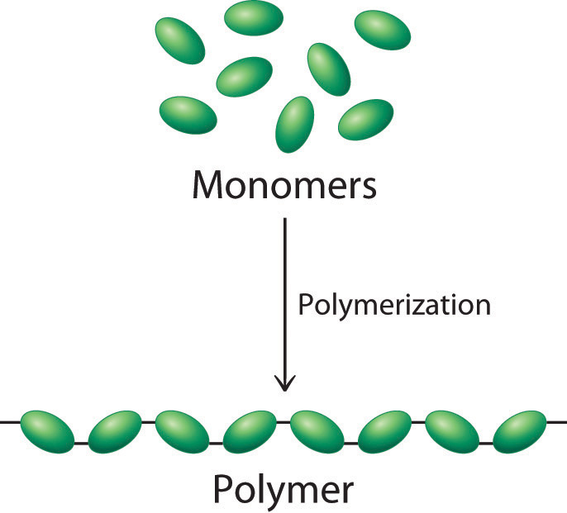
Polymers
Definition: A large molecule made from repeated subunits (monomers)
Synthetic polymers include:
Polystyrene
Poly(vinyl alcohol) (PVA)
Poly(vinyl chloride) (PVC)
Polyester
Can be classified by method of formation:
Addition polymers
Condensation polymers

Slide 4
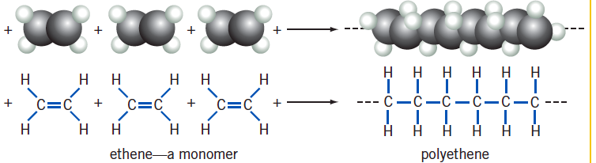
Addition Polymers
Formed from alkene monomers which undergo addition reactions to form a repeating pattern.
Note that the name of the product (polyethene) is the name of the monomer (ethene) with the prefix “poly”. There are no double bonds in polyethene.
catalyst
catalyst

Slide 5
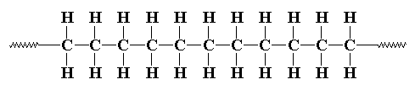
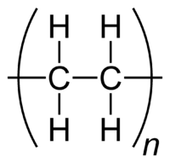
Addition Polymers
Instead of showing a long chain, polymers can be represented by showing the repeating unit.
…where n is a large number (can be in the 1000s).
simplifies to…

Slide 6
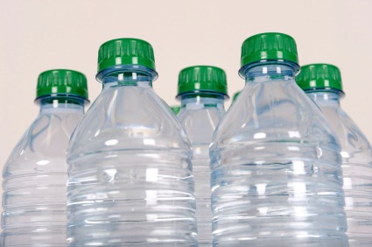
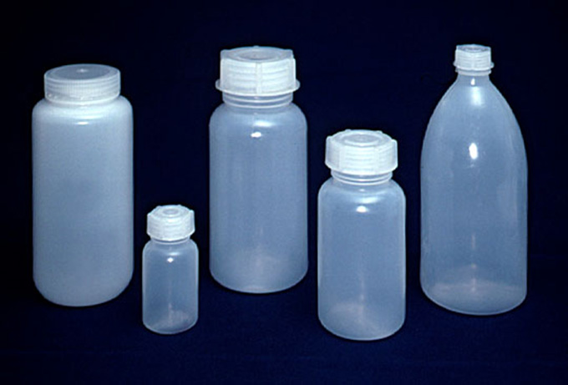
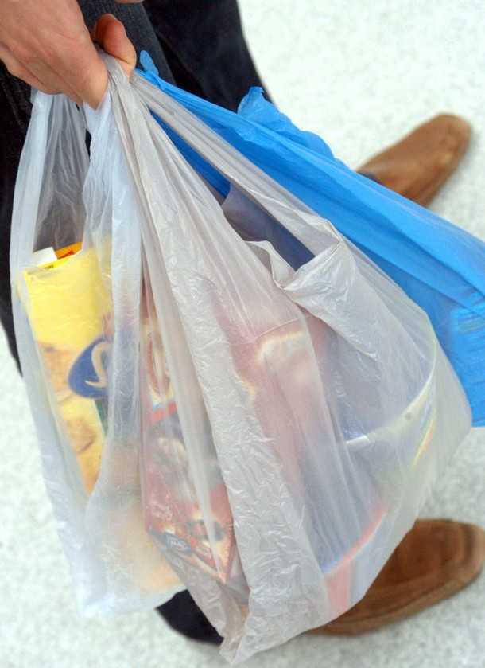
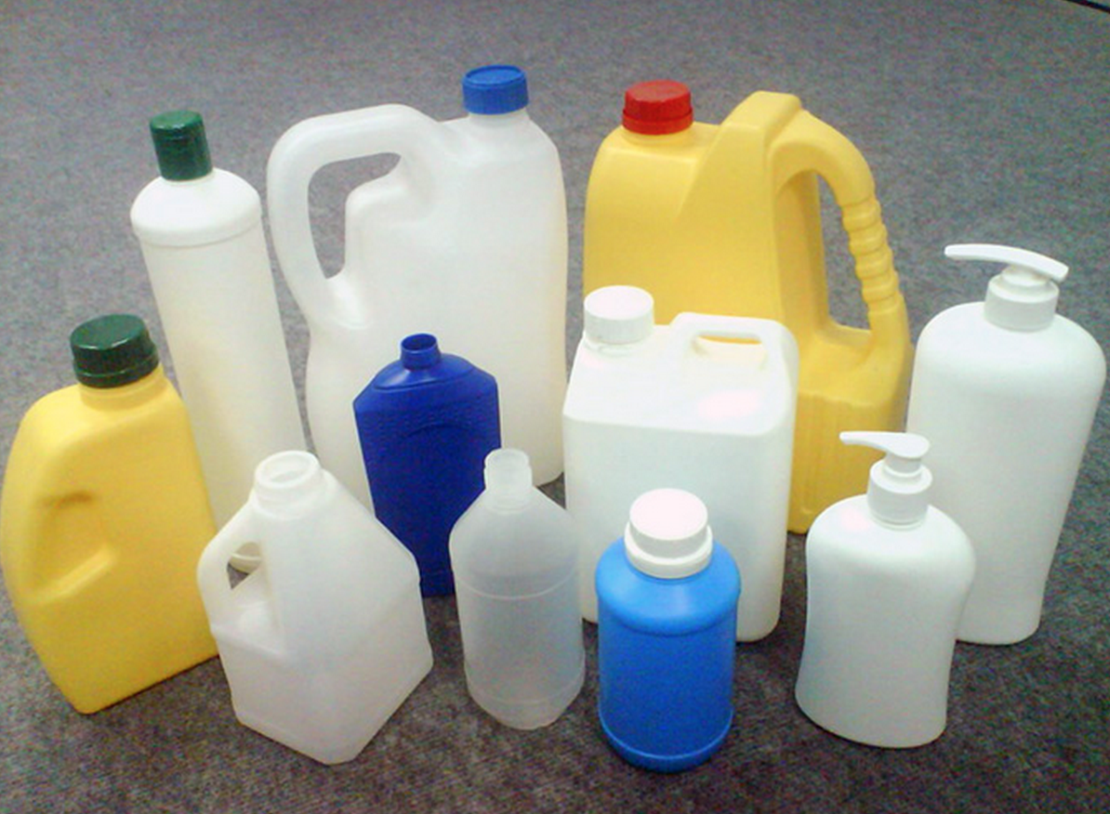
Addition Polymers
Photos of polyethene:

Slide 7
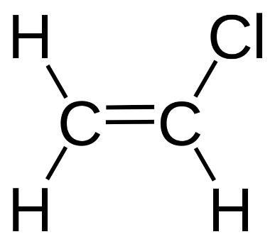
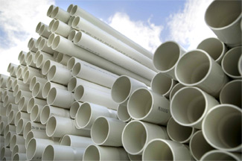
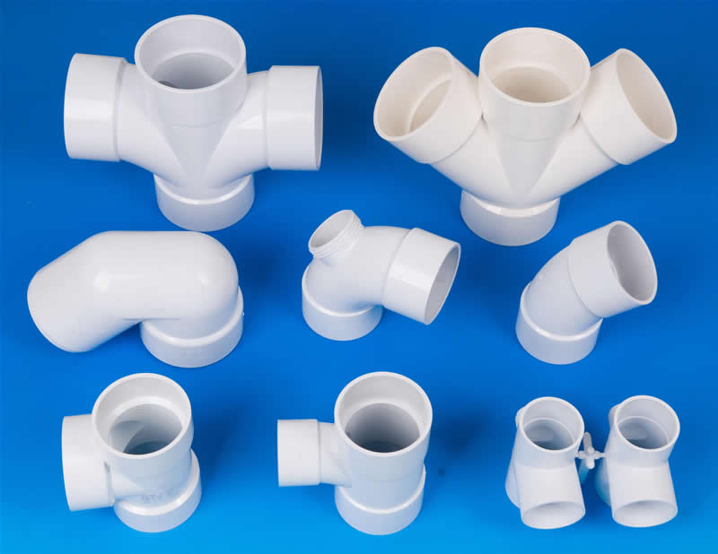
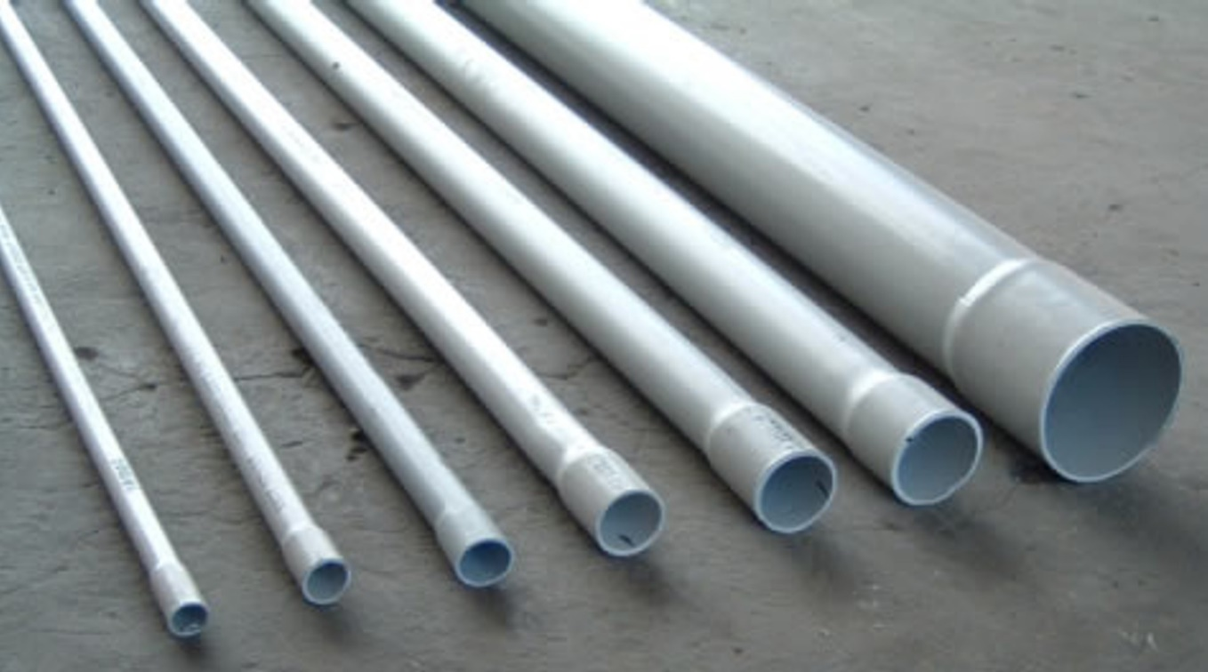
Addition Polymers
Monomer: Vinyl chloride Polymer: Poly(vinyl chloride) PVC
A non-systematic name for chloroethene
or…
n
^ Show open chain including at least three repeating units
^ One repeating unit in brackets

Slide 8
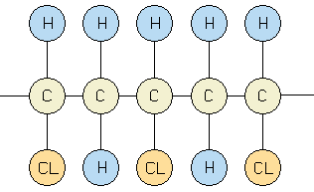
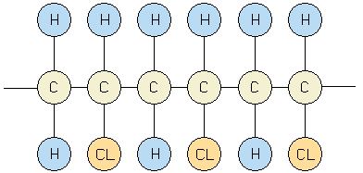
Addition Polymers
NOTE: Be careful about where you start the beginning and end of chain drawings.
Even when drawing a chain with more than one unit, it should make a repeating pattern.
GOOD:
BAD:
If this pattern repeated then you would have two chlorines next to each other…

Slide 9
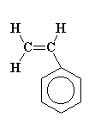
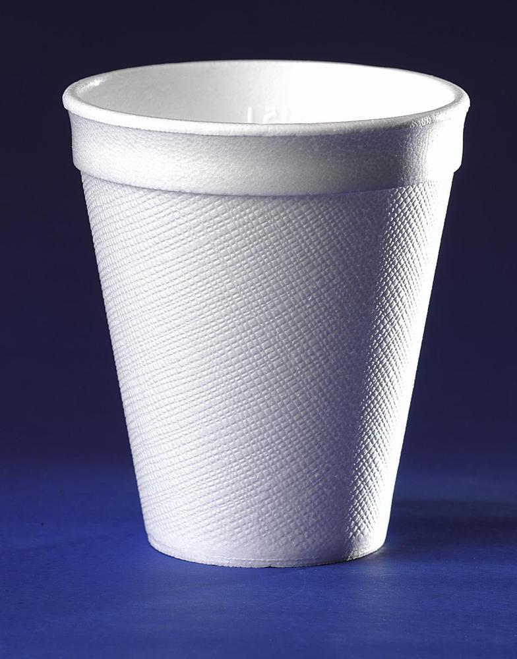
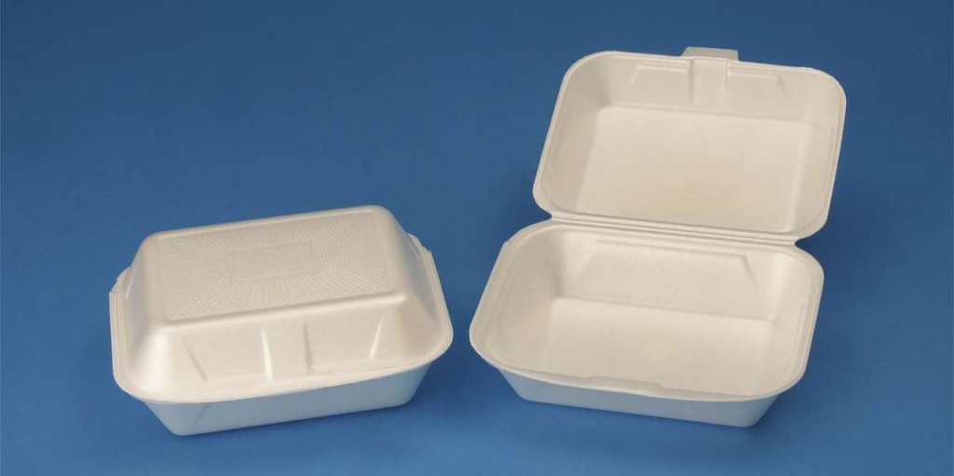
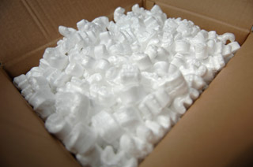
Addition Polymers
Monomer: Styrene Polymer: Polystyrene
or…
n
^ Show open chain including at least three repeating units
^ One repeating unit in brackets

Slide 10
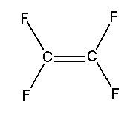
Addition Polymers
Monomer: Tetrafluoroethene Polymer: Polytetrafluoroethene (__________)
or…
n
^ Show open chain including at least three repeating units
^ One repeating unit in brackets

Slide 11
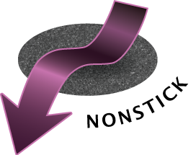
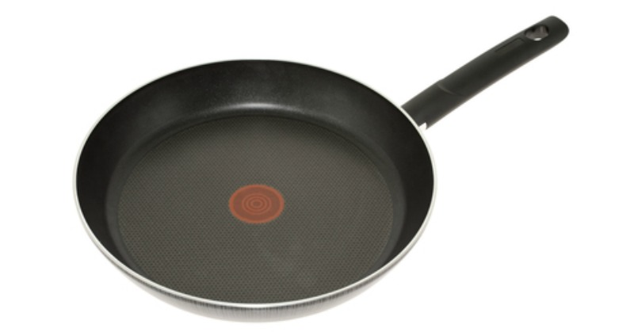
Addition Polymers
Monomer: Tetrafluoroethene Polymer: Polytetrafluoroethene (Teflon)
or…
n
^ Show open chain including at least three repeating units
^ One repeating unit in brackets

Slide 12

Addition Polymers
Monomer: __________________ Polymer: _______________________
or…
n

Slide 13
Addition Polymers
Monomer: __________________ Polymer: _______________________
or…
n

Slide 14
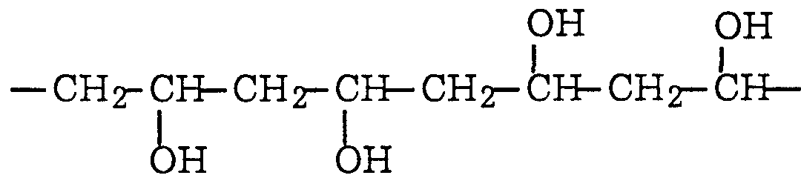
Addition Polymers
Monomer: __________________ Polymer: poly(vinyl alcohol) PVA
or…
n

Slide 15

Syllabus
addition reactions can be used to produce polymers, including polyethene and polytetrafluoroethene
the structure of an addition polymer can be predicted from its monomer and the structure of an addition polymer can be used to predict the monomer from which it was derived

Slide 16
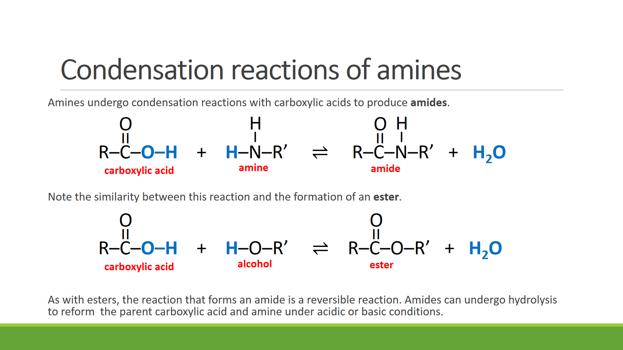
Condensation Polymers
Recall: A condensation reaction is a reaction that produces water as a byproduct.

Slide 17
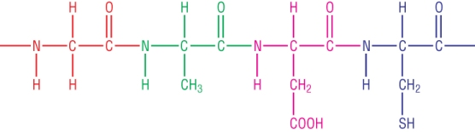
Condensation Polymers
A condensation polymer is produced by adding monomers through condensation reactions.
They may be:
polyesters (monomers joined by ester groups)
polyamides (monomers joined by amide groups)
Polypeptides are biological versions of polyamides. They were constructed when monomers with COOH groups and NH₂ groups joined through condensation reactions.

Slide 18
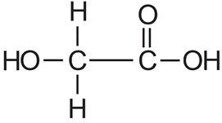
Polyesters
Homopolymer (single monomer):
A polyester can be made from a single monomer if it includes both a COOH and an OH group.
Monomer: Glycolic acid
Polymer:

Slide 19
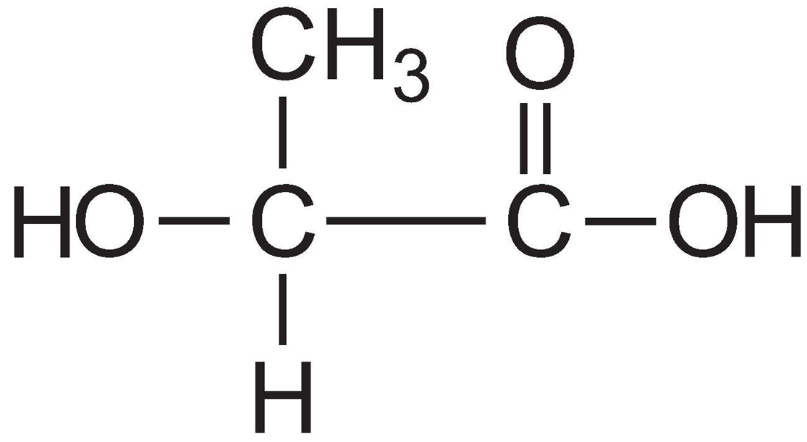
Polyesters
Monomer: Lactic acid
Polymer:

Slide 20


Polyesters
Copolymer (two monomers):
Copolymers have two alternating monomers. In a polyester, this can happen if one molecule is a diol (two –OH groups) and another is a dicarboxylic acid (two –COOH groups).
Monomers:
Polymer:

Slide 21
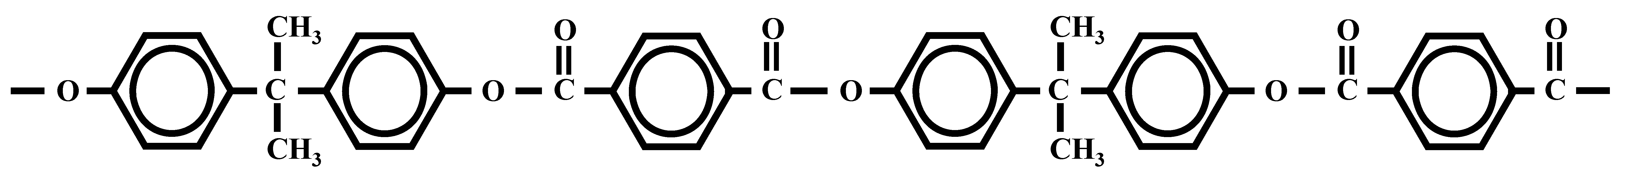
Polyesters
Going backwards:

Slide 22
Polyesters
Going backwards:
c

Slide 23
Polyesters
These were originally carboxylic acid groups
Going backwards:
These were originally alcohol groups

Slide 24
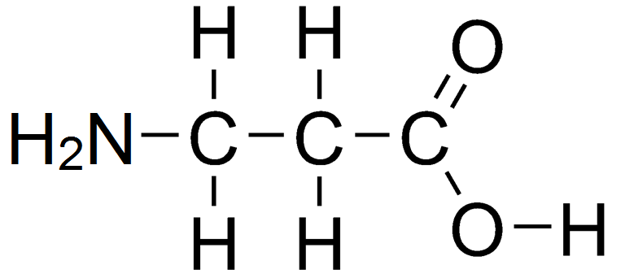
Polyamides
Homopolymer (single monomer):
A polyamide can be made from a single monomer if it includes both a COOH and an NH₂ group.
Monomer: 3-aminopropanoic acid
Polymer:

Slide 25
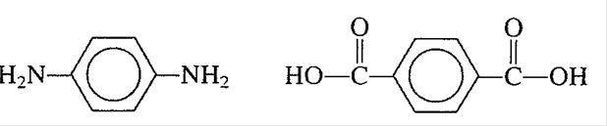
Polyamides
Copolymer (two monomers):
Polyamides can also be formed from the reaction between a diamine and a dicarboxylic acid.
Monomers:
Polymer: Kevlar

Slide 26

Polyamides
Monomers:
Polymer: Nylon 6,6

Slide 27

Polyamides
Polymer:

Slide 28
Polyamides
Polymer:

Slide 29
Polyamides
These were originally carboxylic acid groups
Polymer:
These were originally amine groups

Slide 30
Syllabus
condensation reactions can be used to produce polymers, including polyamides and polyesters
the structure of a condensation polymer can be predicted and drawn from its monomer(s) and the structure of a condensation polymer can be used to predict the monomer(s) from which it was derived

Slide 31
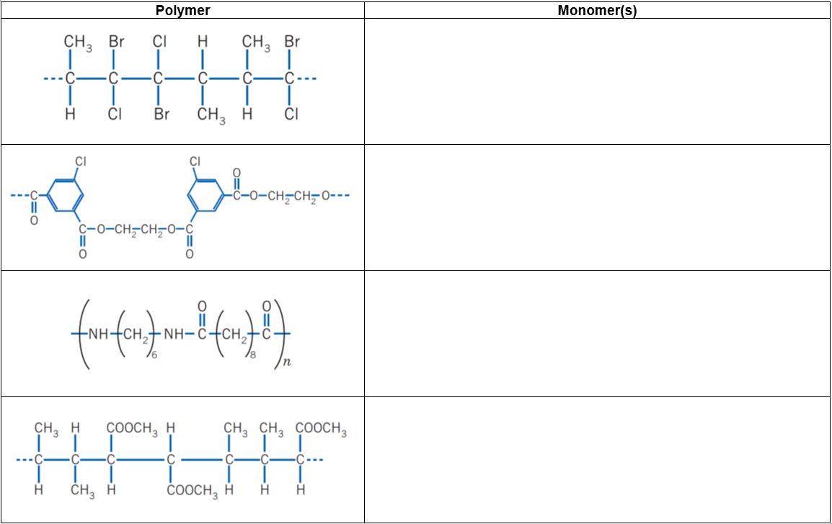

Slide 32
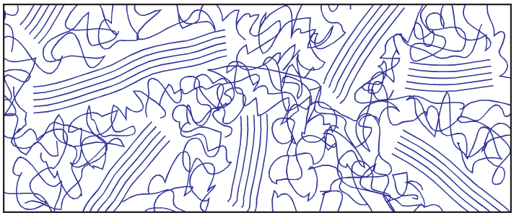
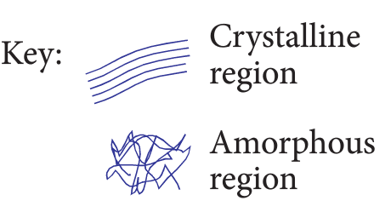
Properties and Uses of Polymers
Crystallinity: Linear polymers have some parts of the molecule that are ordered (crystalline) and some parts that are jumbled (amorphous). The degree of crystallinity can be controlled by altering reactions conditions and catalysts used.
 | Crystalline | Amorphous
Intermolecular forces | Stronger due to close proximity of chains | Weaker due to gaps between chains
Associated properties | Greater rigidity Opaque Greater density Higher melting/softening point Impermeable to water, air | More flexible Transparency Lower density Lower melting/softening point

Slide 33
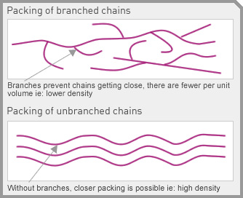
Properties and Uses of Polymers
Chain branching: Extreme reaction conditions can cause chain branching.
Unbranched chains tend to have more crystalline regions as the polymer chains can pack close together, leading to stronger intermolecular forces.

Slide 34
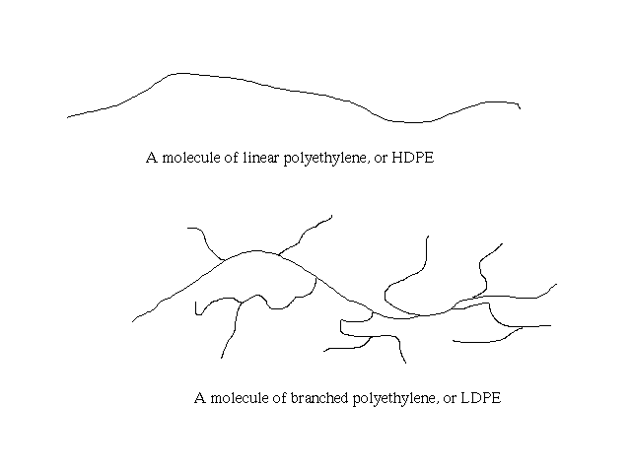
Polyethene
Comes in two varieties: High Density Polyethene (HDPE) and Low Density Polyethene (LDPE)

Slide 35

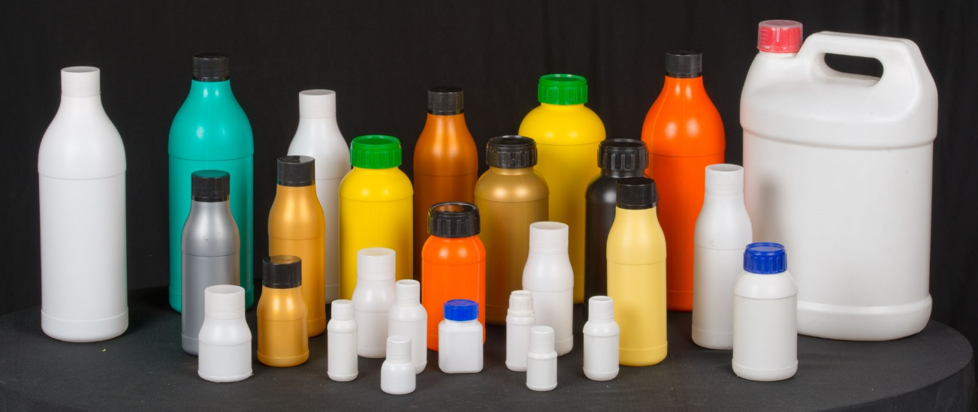
High Density Polyethene (HDPE)
Reaction conditions: Relatively low temperature and pressure (60 °C, a few atmospheres)
Structure: Linear chains with many crystalline regions. Strong dispersion forces.
Properties: Dense, tough, opaque, impermeable to water vapour
Uses: Detergent bottles, bottle caps, food storage containers

Slide 36
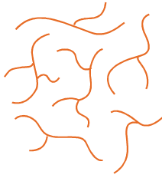
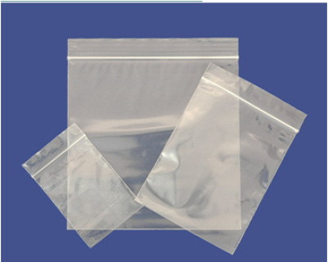
Low Density Polyethene (HDPE)
Reaction conditions: Relatively high temperature and pressure (300 °C, 1000-3000 atmospheres)
Structure: Significant chain branching. Amorphous. Weaker dispersion forces.
Properties: Flexible, transparent
Uses: Plastic bags, plastic food wraps

Slide 37
Syllabus
industry produces a vast range of plastics, including addition polymers (polyethene, polytetrafluoroethene) and condensation polymers (nylon and polyethylene terephthalate [PET]) which have different properties and uses

Slide 38
Soaps
Soaps are the salts of fatty acids. They have a long hydrocarbon ‘tail’ and a polar carboxylate head.
The following diagram shows the full structure of a soap
Hydrocarbon tail:
Non-polar
Hydrophobic
Dissolves non-polar grease and fats (dispersion forces)
Ionic head:
Polar
Hydrophilic
Dissolves in water (ion-dipole forces)

Slide 39
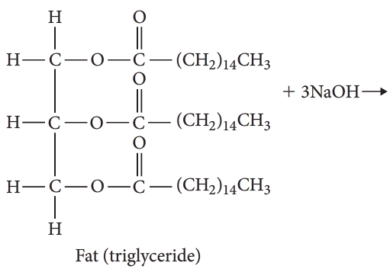
Saponification
Soaps are produced from the alkaline hydrolysis of fats and oils. This process of soap making is referred to as saponification.
+
+
+

Slide 40
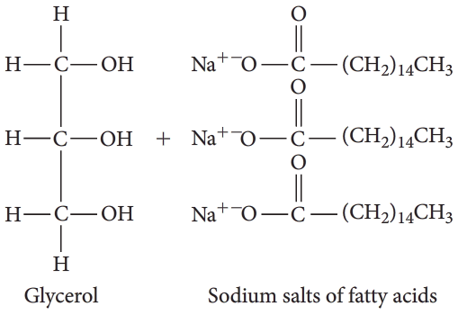
Saponification
Soaps are produced from the alkaline hydrolysis of fats and oils. This process of soap making is referred to as saponification.

Slide 41
Saponification
Write an equation for the saponfication of the following mixed triglyceride.
Mixed triglyceride

Slide 42
Saponification
During the production of soap the following processes occur:
1. Triglyceride is boiled with sodium hydroxide to perform hydrolysis reaction
2. Salt is added to the mixture to cause the sodium salt of the fatty acid (i.e. the soap) to precipitate
3. Soap is filtered and purified by washing with water.
4. The filtrate undergoes distillation to retrieve the dissolved glycerol

Slide 43
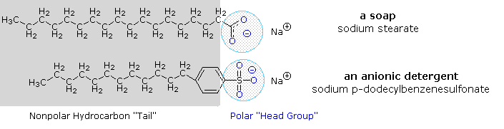
Detergents
Similarities to soap: They both have a non-polar hydrocarbon tail and a polar head.
Differences to soap: Detergents have sulfonate head (SO₃⁻) instead of carboxylate head (COO⁻)

Slide 44
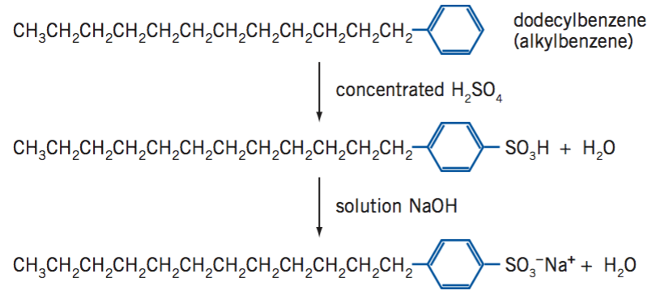
Synthesis of Detergents
Precursor molecule is an alkylbenzene (sourced from petrochemical industry).

Slide 45
Syllabus
Soaps:
the structure of soaps contains a non-polar hydrocarbon chain and a carboxylate group
the base hydrolysis (saponification) of fats (triglycerides) produces glycerol and the salt of a long chain fatty acid (soap)
Detergents:
the structure of the anionic detergents derived from dodecylbenzene contains a non-polar hydrocarbon chain and a sulfonate group

Slide 46

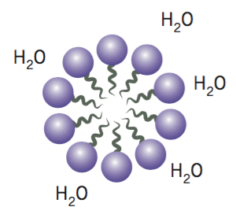
Properties of Soaps & Detergents
Both soaps and detergents have a polar head and a non-polar tail.
The polar head is attracted to water molecules (hydrophilic) through hydrogen bonding and ion-dipole forces
The non-polar tail is not attracted to water molecules (hydrophobic). It is attracted to other non-polar substances through dispersion forces.
Solutions containing soaps/detergents form micelles – a spherical arrangement of molecules. Hydrocarbon tails on the inside of the micelle are shielded from water molecules.
Non-polar tail
Polar head

Slide 47
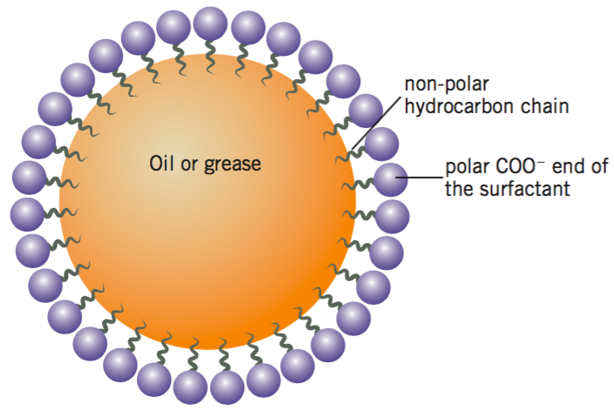
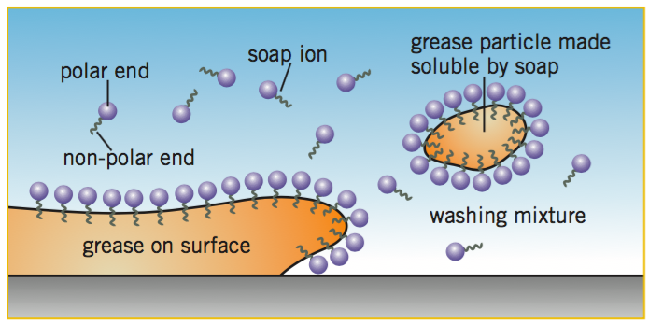
Soaps and detergents are emulsifiers and surfactants. Emulsifiers are substances that allow two normally immiscible substances to dissolve in each other.
The main use of soaps and detergents is to dissolve non-polar substances like grease and oil.
Non-polar tails interact with oil and grease through dispersion forces
Polar heads interact with water molecules through ion-dipole forces and H bonds

Slide 48
Hard Water
‘Hard water’ is water containing dissolved Ca²⁺, Mg²⁺ and Fe²⁺.
Soaps forms an insoluble precipitate with ions in hard water. This is called soap scum.
2 CH₃(CH₂)₁₆COO⁻(aq) + Ca²⁺(aq) → (CH₃(CH₂)₁₆COO)₂Ca(s)
Detergents do not form precipitates with ions in hard water.
e.g. (CH₃(CH₂)₁₁C₆H₅SO₃)₂Ca is soluble.

Slide 49
Syllabus
the cleaning action of soaps and detergents can be explained in terms of their non-polar hydrocarbon chain and charged group
the properties of soaps and detergents in hard water can be explained in terms of the solubilities of their calcium salts

Slide 50
Rate & Yield (Revision)
For reactions involving equilibrium reactions, it is important to both consider reaction rate (speed) and yield (amount of product at equilibrium).
Methods for Maximising Rate:
Increase temperature Increases number of collisions Greater proportion of particles have E_{K} > E_{a}
Increase pressure of gases Increases number of collisions
Increase surface area Increases number of collisions
Addition of a catalyst Decreases E_{a} by providing alternate pathway. Greater proportion of collisions lead to successful reactions

Slide 51
Rate & Yield
Methods for Maximising Yield:
Use high or low temperatures High temperatures favour endothermic reactions Low temperatures favour exothermic reactions
Use high or low pressures High pressures favour side with least moles of gas Low pressures favour side with most moles of gas
Remove the product Decreasing [product] will slow the reverse reaction, shifting equilibrium to the right
Recycling reactants This decreases wastage. Also increases [reactants] which favours forwards reaction, shifting equilibrium to the right

Slide 52
Rate & Yield
Compromise:
Sometimes there is a conflict between ideal reaction conditions for optimum rate and yield. In these cases, a moderate temperature or pressure may be chosen; one which provides an acceptable balance between rate and yield.
e.g. CO(g) + 2 H₂(g) ⇌ CH₃OH(g); ΔH = -90.7 kJ
 | Temperature | Pressure
Ideal conditions for fast rate | High | High
Ideal conditions for max yield
Likely conditions used (low, moderate or high)

Slide 53
Haber Process
See page of notes in workbook

Slide 54
Contact Process
See page of notes in workbook

Slide 55
Syllabus
reagents and reaction conditions are chosen to optimise yield and rate for chemical synthesis processes, including:
o the production of ammonia (Haber process)
o the production of sulfuric acid (Contact process)

Slide 56

Reaction Sequences
Chemical synthesis often involves multiple reaction steps.
Linear Sequence:
O₂
O₂
H₂SO₄
H₂O
S
SO₂
SO₃
H₂S₂O₇
H₂SO₄
Intermediates

Slide 57
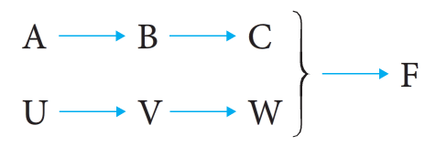
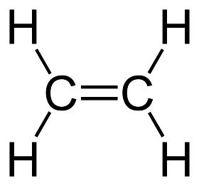
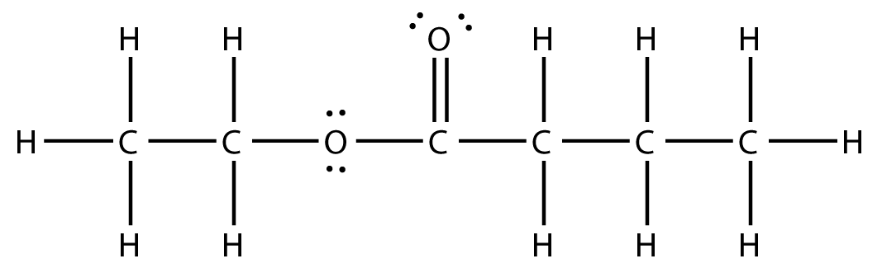
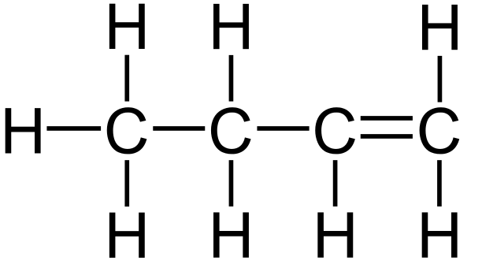
Reaction Sequences
Convergent Sequence:
Ethyl butanoate

Slide 58
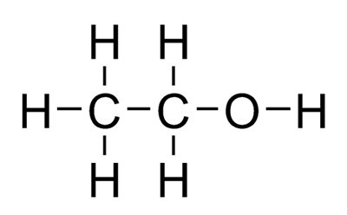


Reaction Sequences
Convergent Sequence:
H₂O
H₂O
oxidation
Ethyl butanoate

Slide 59
The reaction pathway below represents the synthesis of compound C. Show the semistructural formulas of compounds A, B and C.

Slide 60
Construct a reaction sequence to produce…

Slide 61
Syllabus
chemical synthesis processes may involve the construction of reaction sequences with more than one chemical reaction, including the hydrolysis of ethene to form ethanol and the subsequent reaction of ethanol with acetic (ethanoic) acid to produce ethyl ethanoate

Slide 62

Green Chemistry
Syllabus: Scientific knowledge can be used to design alternative chemical synthesis pathways, taking into account sustainability, local resources, economics and environmental impacts (green chemistry), including the production of ethanol and biodiesel.
Green chemistry refers to the design of chemical products and processes that are environmentally friendly.

Slide 63
Green Chemistry
https://greenchemuoft.wordpress.com/green-chemistry-video-series/
1. Prevention
It is better to prevent waste than to treat to clean up waste after it has been created.
2. Atom Economy
Synthetic methods should be designed to maximise the incorporation of all materials used in the process into the final product.
3. Less hazardous chemical synthesis
Wherever practical, the synthetic processes used to generate substances should possess little or no toxicity to human health and the environment.

Slide 64
Green Chemistry
4. Design safer chemicals
Chemical products should be designed to be as efficient as possible and have the least toxicity possible.
5. Use safer solvents and auxillaries
Solvents and separating agents should be used as little as possible and if needed they should be non-toxic. Solvents make up 50% of the total chemicals used in most processing plants.
6. Design for Energy Efficiency.
Energy requirements should be minimised in order to limit impact on environment and economy. If possible reactions should be conducted at ambient temperature and pressure.

Slide 65
Green Chemistry
7. Use of renewable feedstocks
Raw materials (feedstocks) should be renewable whenever this is technically and economically practical. This will prevent depletion of finite resources.
8. Reduce number of steps
Avoid unnecessary steps in synthesis. Each step requires additional reagents and can generate waste.
9. Use catalysts
Catalysts can be used in small amounts and can be re-used. It is preferable to use a catalyst instead of adding other reagents which could generate waste.

Slide 66
Green Chemistry
10. Design products that degrade
Chemical products should break down rather than persist in the environment.
11. Real time analysis and monitoring
Develop techniques for real-time monitoring of conditions and waste. e.g. monitoring changes in pH.
12. Accident prevention
Use substances which will minimize risk of explosions, fires, etc.

Slide 67

Atom Economy
$Atom economy=\frac{M(desired products)}{M(all reactants)}×100$
e.g. Calcium oxide can be produced via the following reaction: CaCO₃ → CaO + CO₂
$Atom economy=\frac{M\left(CaO\right)}{M\left({CaCO}_{3}\right)}×100=\frac{56.08}{100.09}×100=56.0\%$
This means 56.0% of the mass of reactants ends up being used in the desired product(s). The greater the atom economy, the less waste produced.

Slide 68
Iboprofen
https://greenchemuoft.wordpress.com/2014/04/04/greenchemprinciple2/
Ibuprofen is used as an over-the-counter painkiller. It was patented by the Boots company in the 1960s, and was originally prepared using a six-step synthesis (see flow chart on left).
The patent to ibuprofen expired in the mid-1980s, which allowed other companies to also develop the drug. A new company, BHC, developed an alternative 3-step method for developing ibuprofen (shown right). This method is commonly called the ‘green synthesis’ of ibuprofen as it involves less waste.

Slide 69
Ethanol
Important uses:
Fuel: Ethanol is the world’s most widely used biofuel. Can be blended into petrol (E10 fuel = 10% ethanol, 90% petrol)
Solvent: Having polar (-OH) and non-polar (CH₃CH₂-) groups allows ethanol to dissolve a range ionic, polar and non-polar substances. It is the second most important solvent after water.

Slide 70
Ethanol production: Hydrolysis of ethene
Most common method for producing ethanol.
CH₂=CH₂(g) + H₂O(g) ⇌ CH₃CH₂OH(g) ΔH = -45 kJ mol⁻¹
The ethene is sourced from the catalytic cracking of fossil fuels.
Based on the equation given, predict the temperature and pressure conditions used (low-medium-high). Give a very brief reason.
Temperature: ___________ Reason: _____________________________________________
Pressure: ___________ Reason: _____________________________________________

Slide 71
Ethanol production: Hydrolysis of ethene
Actual conditions used:
Temperature 300 °C
Pressure: 60-70 atmospheres Higher pressures have higher operating costs and can cause ethene to polymerise to form polyethene
Catalyst: H⁺ (e.g. concentrated H₃PO₄)

Slide 72
Ethanol production: Fermentation
Fermentation uses biological organism (yeast) and its enzymes to synthesise ethanol. Ethanol produced in this method can be referred to as ‘bioethanol’, a type of ‘biofuel’.
In the process of fermentation:
A suitable grain or fruit is mashed (e.g. corn)
An appropriate strain of yeast is added
Air is excluded
The mixture is kept at 37 °C
Enzymes in mixture convert starch or sucrose to glucose and fructose. The yeast consumes the simple sugars to produce ethanol.
C₆H₁₂O₆(aq) → 2 CH₃CH₂OH(aq) + 2 CO₂(g)

Slide 73
Ethanol production: Fermentation
Industrial considerations:
Yeast is killed in solutions with ethanol concentrations >15%. This limits the purity of ethanol that can be made.
Reaction rates are very slow at the given temperature. Temperature cannot be increased without denaturing enzymes / killing yeast.

Slide 74
Ethanol production
 | Hydration | Fermentation
Type of raw material | Non-renewable (ethene from crude oil) | Renewable (glucose from plants)
Type of process | Continuous (runs all the time) | Batch (stop-start)
Labour | Few workers needed | A lot of workers needed
Rate of reaction | Fast | Slow
Conditions | Relatively high (300 °C) 60-70 atmospheres | Warm (30 °C) 1 atmosphere pressure
Purity of product | Pure (no by-products made) | Impure (needs treatment)
Energy needed | A lot | A little

Slide 75
Enzymes
Reminder: Catalysts increase reaction rates by offering an alternate reaction pathway with lower activation energy. This increases the proportion of particles that have sufficient energy to react.

Slide 76
Enzymes are protein molecules which are biological catalysts. The shape of the enzyme is key in allowing it to act as a catalyst. Refer to notes for structure of proteins.

Slide 77
Enzymes
Explain the importance of enzymes in chemical synthesis. (4 marks)
Increases the rate of chemical reactions (1)
Allows reactions to occur at lower temperatures and pressures while maintaining acceptable rates. (1)
This reduces operating costs for industrial plants (e.g. less heating costs) (1)
Enzymes are not consumed in chemical reactions, so can be reused without additional cost (1)

Slide 78
Syllabus
Scientific knowledge can be used to design alternative chemical synthesis pathways, taking into account sustainability, local resources, economics and environmental impacts (green chemistry), including the production of ethanol and biodiesel.
enzymes are protein molecules which are biological catalysts and can be used on an industrial scale to produce chemicals that would otherwise require high pressure or temperature conditions to achieve an economically viable rate, including fermentation to produce ethanol versus hydration of ethene

Slide 79
Biodiesel
http://ed.ted.com/lessons/biodiesel-the-afterlife-of-oil-natascia-radice
What is biodiesel? What is its significance?

Slide 80
Triglycerides → Soap (Revision)
Recall: Soaps were prepared from the hydrolysis of triglycerides (fats and oils). The product of saponification was glycerol and a carboxylate ion.

Slide 81
Triglycerides → Biodiesel (New)

Slide 82

Synthesis of biodiesel
Biodiesel is synthesised by a transesterification reaction between a triglyceride and a short-chain alcohol (usually methanol). The reaction requires a catalyst, such as NaOH, KOH or lipase (an enzyme).
General equation:

Slide 83

Synthesis of biodiesel
Complete the equation below to show:
NaOH
+ CH₃OH

Slide 84
Synthesis of Biodiesel: Base-catalysed
Synthesis:
NaOH or KOH catalyst
Low temperatures (~60 °C) and atmospheric pressure.
Higher temperatures would exceed boiling point of alcohol
Excess of alcohol forces reaction to the right.
3:1 mole ratio of alcohol:triglyceride is needed for stoichiometric ratio.
6:1 mole ratio of alcohol:triglyceride produces very high yields (>99%)
Isolation:
Glycerol and biodiesel are immiscible, and glycerol is more dense. Forms two layers which can be separated.
Glycerol layer also contains unreacted methanol and NaOH/KOH

Slide 85
Synthesis of Biodiesel: Base-catalysed
Advantages:
Uses a renewable feedstock
Biodiesel product is non-toxic and biodegradable. Burning it is carbon-neutral.
Highly economical with low operating costs
High yield of product despite low temperature and ambient pressure

Slide 86
Synthesis of Biodiesel: Base-catalysed
Disadvantages:
Requires large amounts of arable land to grow crops which can produce vegetable oil.
NaOH/KOH is a hazardous chemical (Green Chemistry)
Does not have a high atom economy (Green Chemistry)
High concentrations of NaOH/KOH cause side reaction: triglycerides react with OH– to form soap. This consumes catalyst, decreases yield, clogs piping and increases separation costs.

Slide 87
Synthesis of Biodiesel: Lipase-catalysed
Alternative method can use lipase (enzyme that breaks down lipids, i.e. fats) instead of NaOH.
_____________________________________________________________________________
Talha, N. S., & Sulaiman, S. (2006). Overview of catalysts in biodiesel production. ARPN Journal of Engineering and Applied Sciences, 11(1), 439-448.
http://www.arpnjournals.org/jeas/research_papers/rp_2016/jeas_0116_3357.pdf
Use the above journal article as a source to compare base-catalysed and lipase-catalysed production of biofuel. Identify advantages and disadvantages of each method.

Slide 88
Syllabus
Scientific knowledge can be used to design alternative chemical synthesis pathways, taking into account sustainability, local resources, economics and environmental impacts (green chemistry), including the production of ethanol and biodiesel.
enzymes are protein molecules which are biological catalysts and can be used on an industrial scale to produce chemicals that would otherwise require high pressure or temperature conditions to achieve an economically viable rate, including fermentation to produce ethanol versus hydration of ethene

